Slide 1

Immigration AI Advisor
Team: Borderless.AI Sprint 1 Presentation
Notes:
Miles

Slide 2

Agenda
Team Member Roles and Responsibilities
Improvements
Project Description
Team Working Agreement
Personas
MVP
Technologies
Algorithms
Diagrams
Product Backlog
Sprint 1 Backlog
Metrics
Retrospective
Sprint 2 Planning and Commitment
Project Demo
Github link
Live Demo
Notes:
Miles

Slide 3
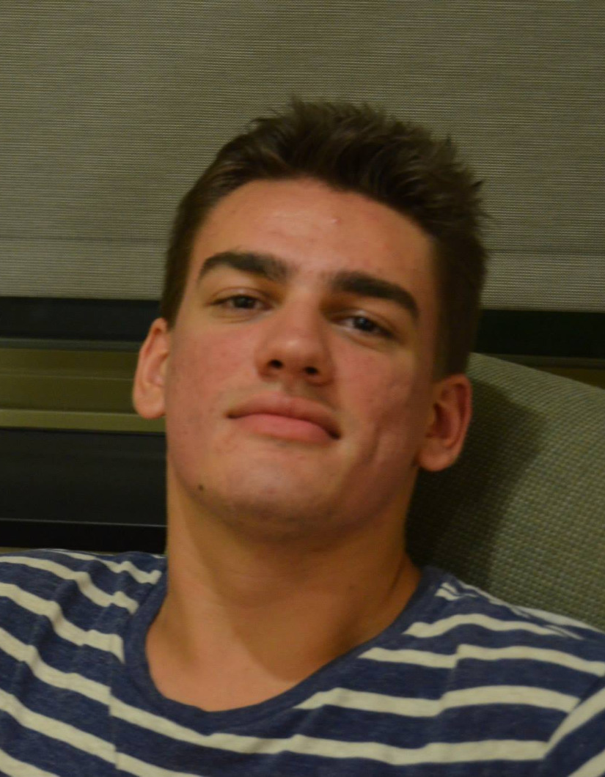
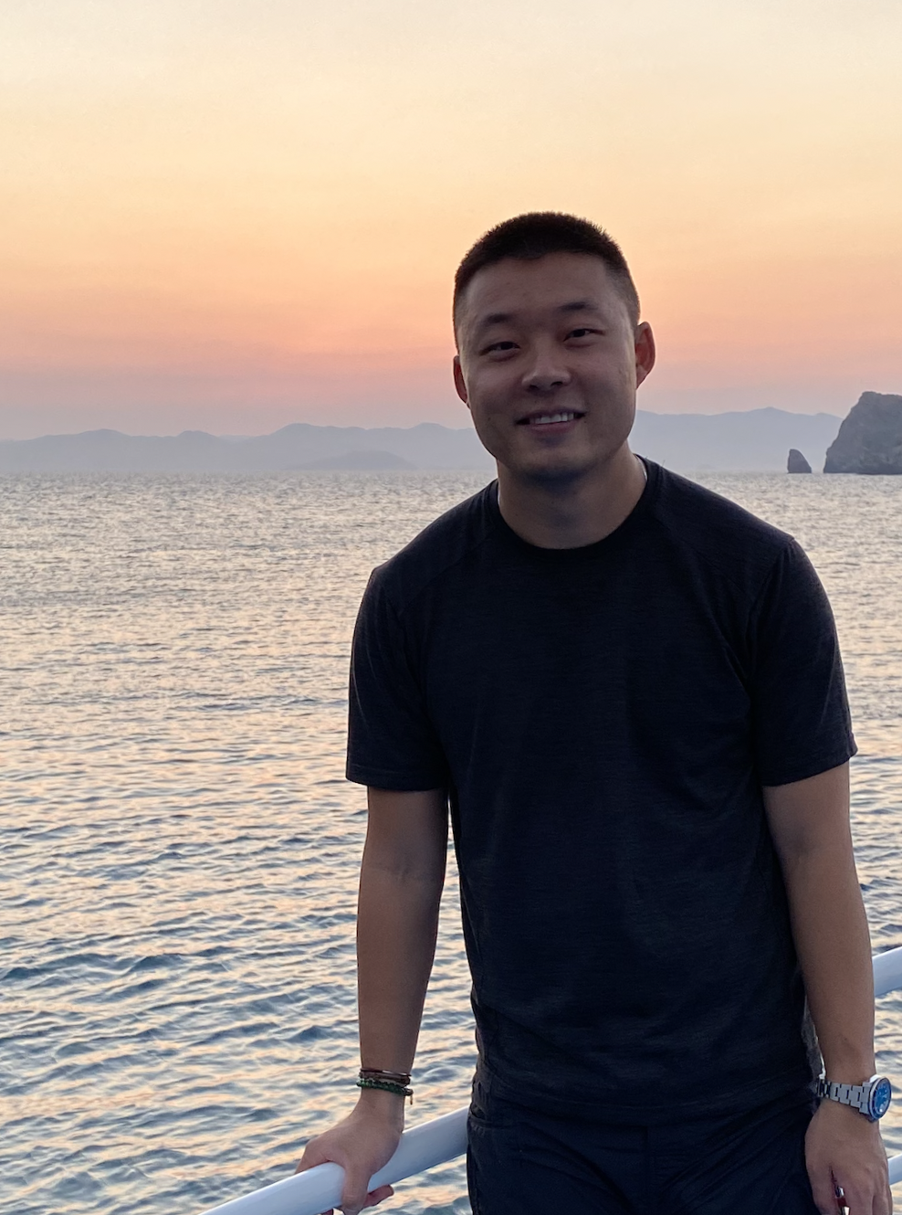
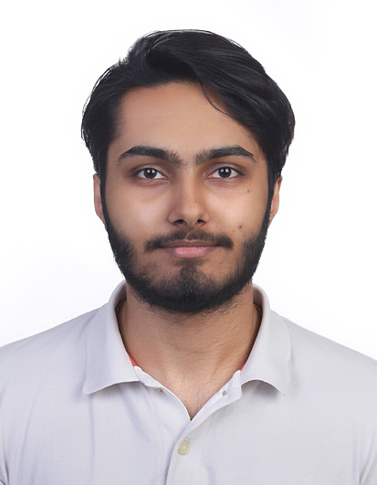


Team Member Roles and Responsibilities
Matt Borkowski
Developer
SCRUM Master
Miles ZhengFerrari
Developer
Team Leader
Nuvorish Paul
Developer
Raj Rahul Parekh
Developer
Santhosh Charudatta
Developer
All team members collaborate as developers, contributing to coding, testing, and feature development.
Notes:
Matt

Slide 4
Improvements
Team Working Agreement
Project Schedule
Personas
Gmail Group: borderlessai@googlegroups.com
Wiki Page
Notes:
Raj

Slide 5
Project Description
Project Name: Immigration AI Advisor
Team: Borderless.AI
Project Description:
Immigration AI Advisor is a AI-based application designed to assist international students with immigration-related queries by reading documents (I-20, I-94) and providing personalized advice based on immigration rules and policies.
Benefit Outcomes:
Faster, more accurate immigration advice for international students.
Reduced burden on international student offices with limited resources.
Improved efficiency in managing immigration-related queries within budget constraints.
Github Link:https://github.com/htmw/2024F-borderless.ai/wiki
Notes:
Nuvorish

Slide 6
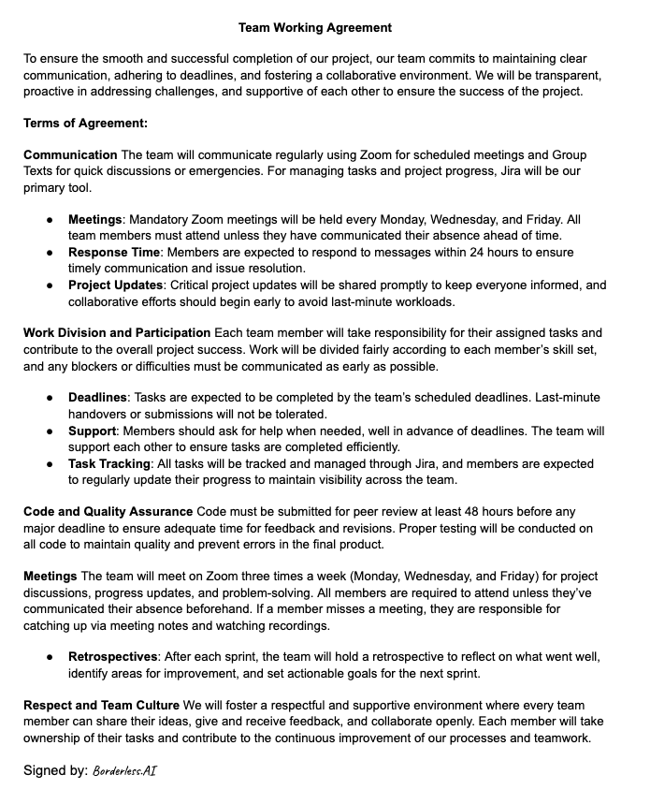
Team Working Agreement
Notes:
Miles

Slide 7
Project Schedule
Sprint 0: Understanding the Project (Pre-Development Phase)
Goal: Gather requirements, define project scope, and identify key user needs.
Activities:
Understand the scope of immigration document handling (I-20, I-94).
Research relevant immigration rules and policies.
Define key features for the Immigration AI Advisor (PDF upload, document parsing, personalized advice).
Set up the development environment and select tech stack (Python, Flask, AI framework).
Initial team roles assignment.
Notes:
Nuvorish

Slide 8
Project Schedule
Sprint 1: Basic PDF Upload & Parsing
Goal: Build and demonstrate the basic functionality of the Immigration AI Advisor.
Tasks:
Implement PDF upload functionality via the web UI.
Develop code for reading and extracting basic information from I-20 PDFs (e.g., Name, DoB).
Establish Flask as the backend for handling requests.
Test and verify that the I-20 upload and parsing process is functional.
Demo the working upload and basic data extraction.
Notes:
Nuvorish

Slide 9
Project Schedule
Sprint 2: Data Fields Expansion & AI Component
Goal: Extend the document parsing capabilities and introduce basic AI-driven advice.
Tasks:
Integrate additional data fields from I-20 (e.g., School Name, Program Dates)
Implement basic AI functionality to begin providing personalized advice
(e.g., identifying common visa statuses).
Ensure the system is flexible enough to handle more complex parsing as needed.
Test for accuracy across multiple types of documents (I-20, I-94).
Notes:
Nuvorish

Slide 10
Project Schedule
Sprint 3: AI Component Enhancement
Goal: Improve the AI’s capability to provide more complex immigration advice.
Tasks:
Refine the AI logic to handle more nuanced queries based on immigration policies.
Add more advanced decision-making capabilities to the AI component.
Enhance the AI model's ability to analyze and cross-reference multiple document types.
Test the AI’s performance and ensure it scales well with increased complexity.
Prepare the Immigration AI Advisor for final testing and potential deployment.
Notes:
Nuvorish

Slide 11

Personas
Name: Sarah Johnson
Age: 35
Role: International Student Adviser
Background:
Sarah has been an adviser for 8 years, handling hundreds of students each semester. She’s responsible for guiding them through immigration processes, ensuring compliance with visa regulations, and managing I-20 and I-94 forms.
Challenges:
Overwhelmed by repetitive tasks (e.g., checking I-20, I-94 documents). Struggles to keep up with changing immigration rules. Limited time for personalized student interactions due to workload.
Goals:
Automate routine tasks to reduce workload. Improve accuracy and efficiency in advising. Free up time for more complex student cases.
How Immigration AI Advisor Helps:
Automates document review (I-20, I-94).
Provides preliminary, personalized immigration advice.
Reduces manual workload, enabling Sarah to focus on complex cases.
Notes:
Santhosh

Slide 12

Personas
Name: Aakken Lee
Age: 22
Role: International Student, 3rd-year undergraduate
Background:
Aakken is studying Computer Science and is on an F-1 visa. He regularly deals with immigration paperwork like I-20s and I-94s, and needs to stay compliant with visa regulations to maintain his legal status in the U.S.
Challenges:
Needs quick, accurate advice on maintaining visa status. Often faces delays due to overburdened advisers. Uncertainty about document requirements or policy changes causes stress.
Goals:
Access immediate immigration information and advice. Avoid potential issues with immigration status.
How Immigration AI Advisor Helps:
Provides instant, accurate responses to common immigration queries.
Offers clear explanations of I-20 and I-94 documents.
Reduces reliance on advice availability for basic information.
Notes:
Santhosh

Slide 13

Personas
Name: Dr. Maria Rodriguez
Age: 50
Role: VP of Office of Global Services
Background:
Dr. Rodriguez’s role focuses on ensuring compliance with immigration regulations while enhancing student support and satisfaction. She’s responsible for strategic planning, resource allocation, and policy implementation.
Challenges:
Ensuring the institution stays compliant with evolving immigration laws. Balancing limited resources with the growing needs of international students.
Goals:
Improve efficiency to better serve students. Use data and automation to ensure compliance with immigration rules while respect the limited budget.
How Immigration AI Advisor Helps:
Streamlines immigration document processing, freeing up adviser resources.
Enhances support for international students, improving satisfaction and retention.
Notes:
Santhosh

Slide 14
MVP
Description:
The MVP of the Immigration AI Advisor focuses on delivering essential functionality to assist international students with their immigration-related needs. The MVP allows users to upload their I-20 document, and the system extracts key information such as their Name and Date of Birth. This basic document parsing provides immediate value by automating a critical task, helping students quickly access and verify important information from their immigration paperwork.
Key Features of the MVP:
PDF Upload: Users can upload an I-20 form through a web interface.
Data Extraction: The system automatically extracts and displays basic information (e.g., Name, Date of Birth).
Usability: Users can interact with the system, receive valuable information instantly, and ensure their immigration documents are processed accurately.
Value to Users:
The MVP solves a practical problem for students by saving time and reducing the complexity of manually reading their immigration documents. It provides immediate utility while laying the groundwork for future enhancements, such as more detailed document parsing and AI-based immigration advice.
Notes:
Raj

Slide 15
Technologies
Languages & Frameworks:
Python, Flask, FastAPI, Pytest, ReactJS, HTML, CSS
Artificial Intelligence:
TensorFlow, PyTorch, Chat GPT4o mini, BART, Claude
Any additional technology we may discover and add as we move on to each sprints.
Notes:
Matt

Slide 16
Algorithms
Regular Expressions/Pattern Matching
To recognize structure of, and extract information from, I-20 formatted forms
ChatGPT 4o mini/ BART/ Claude
LLM’s (Large Language Models), minimally trained language models, to provide the basis of a custom-trained, immigration-oriented “knowledge base”
TensorFlow/ PyTorch:
Might be used for statistical/quantitative analysis and transformation, in order to augment LLMs’ capabilities
Notes:
Matt

Slide 17
Diagrams
Architecture Diagrams
Context Diagram
ER Diagram
Sequence Diagram
State Diagrams
Notes:
Matt

Slide 18
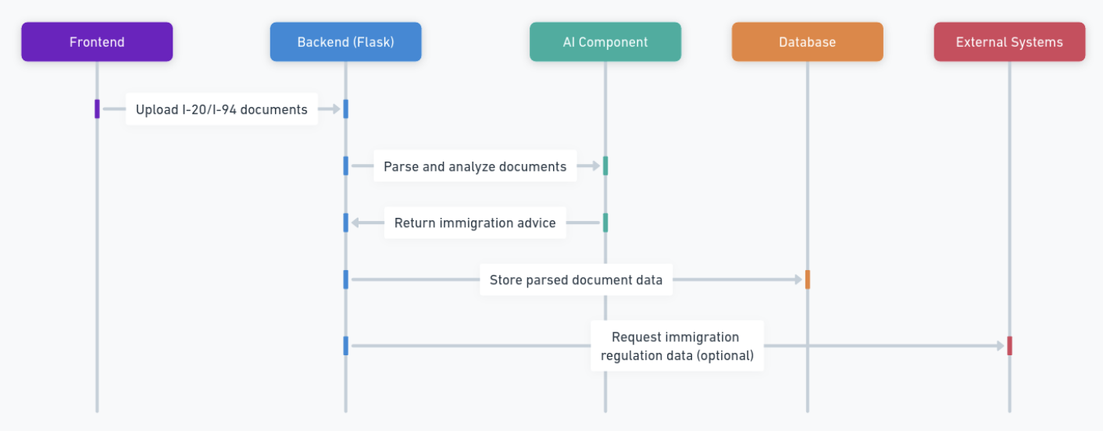
Architecture Diagram
Notes:
Miles

Slide 19
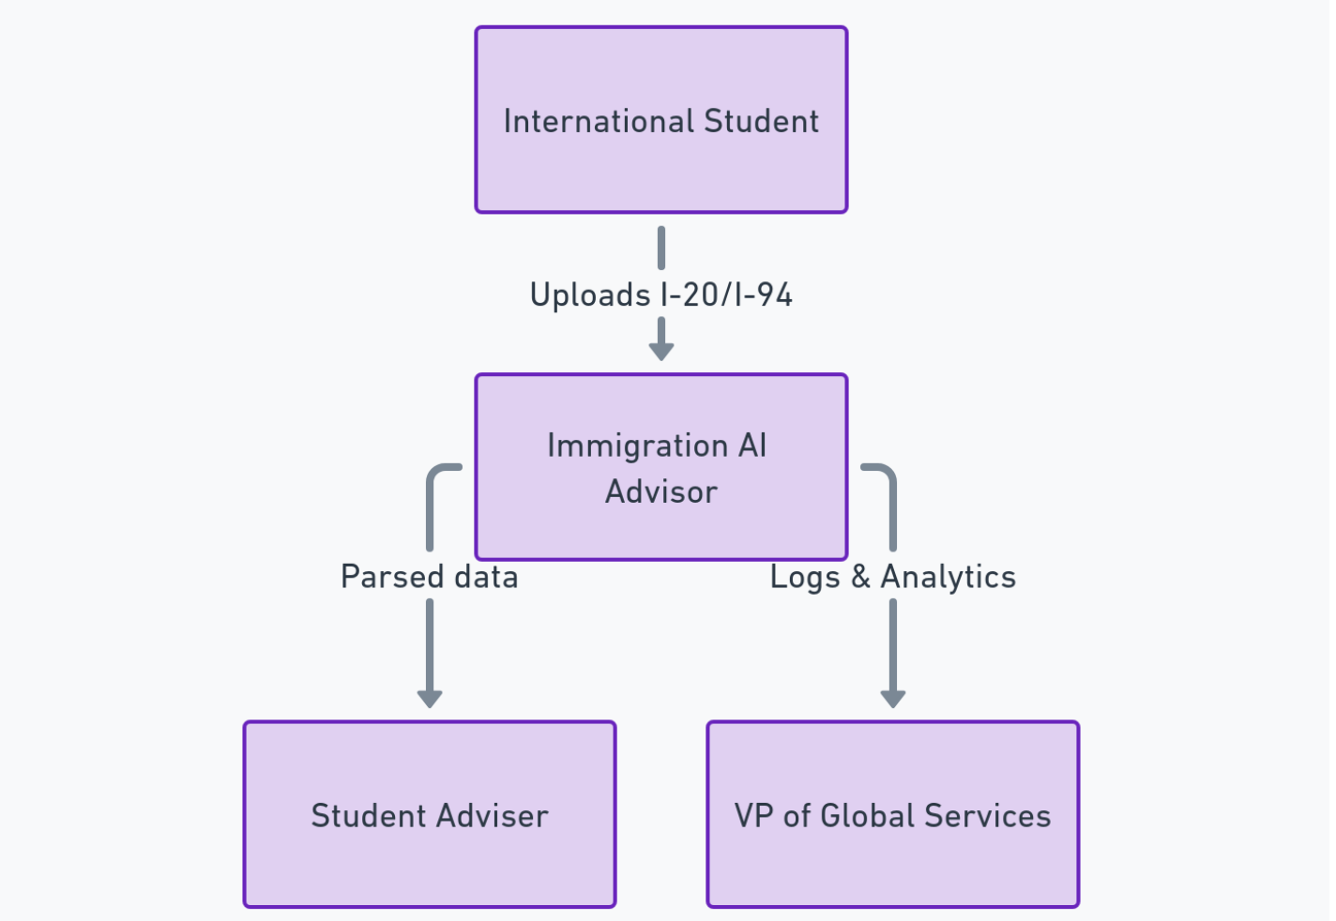
Context Diagram
Notes:
Santhosh

Slide 20
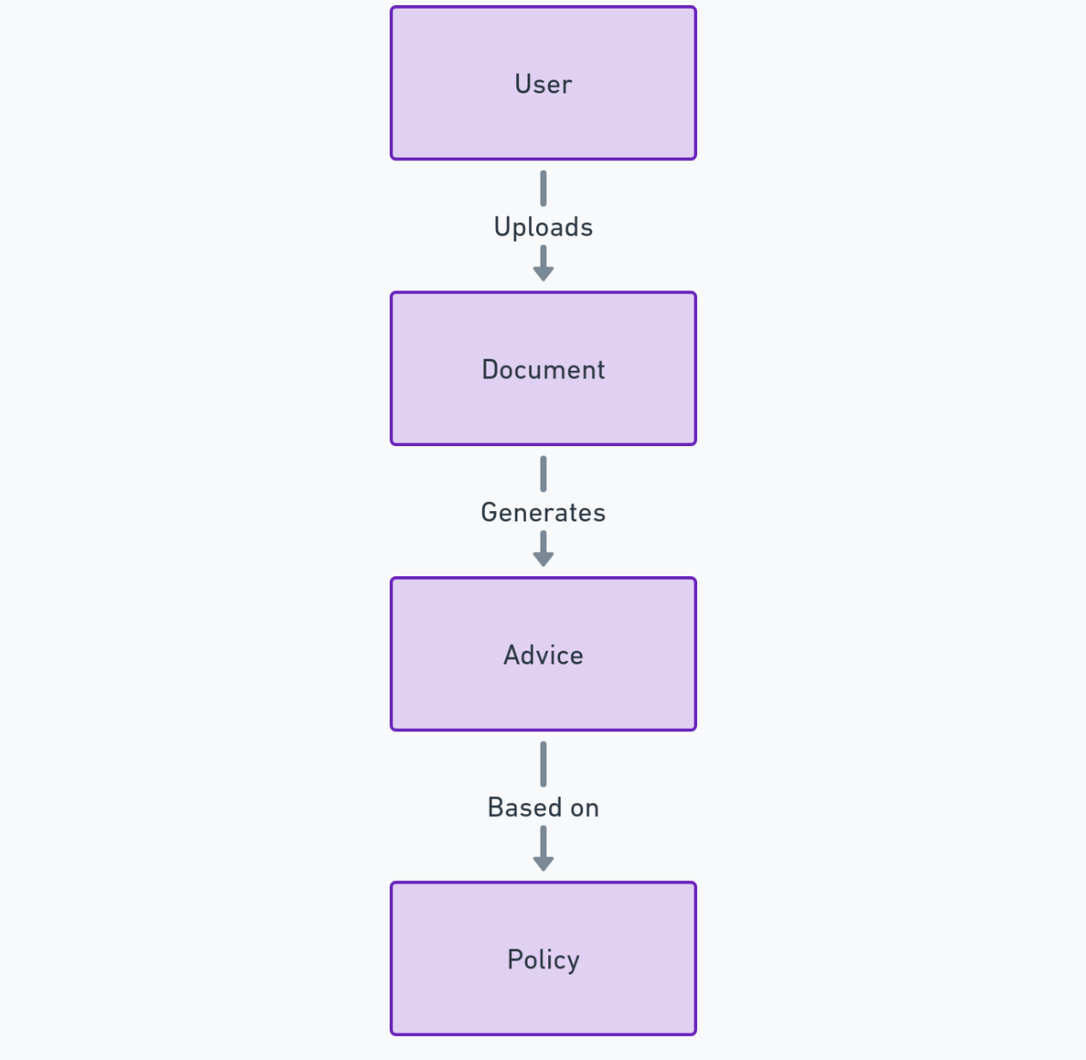
ER Diagram (Entity-Relationship Diagram)
Notes:
Raj

Slide 21
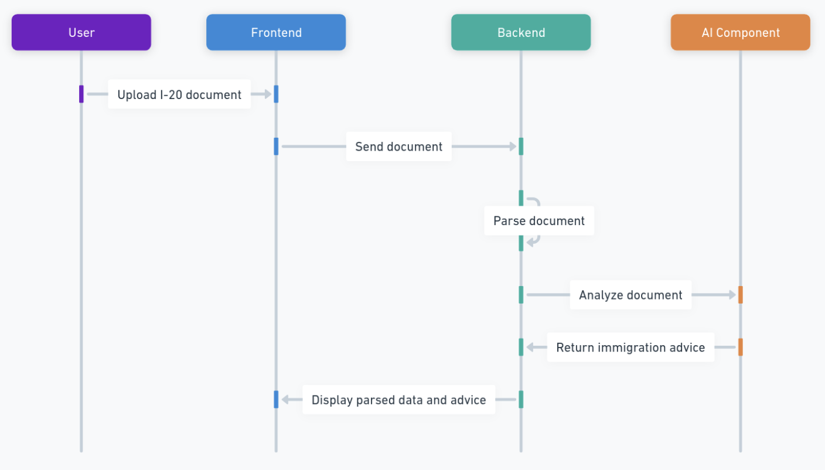
Sequence Diagram
Notes:
Nuvorish

Slide 22
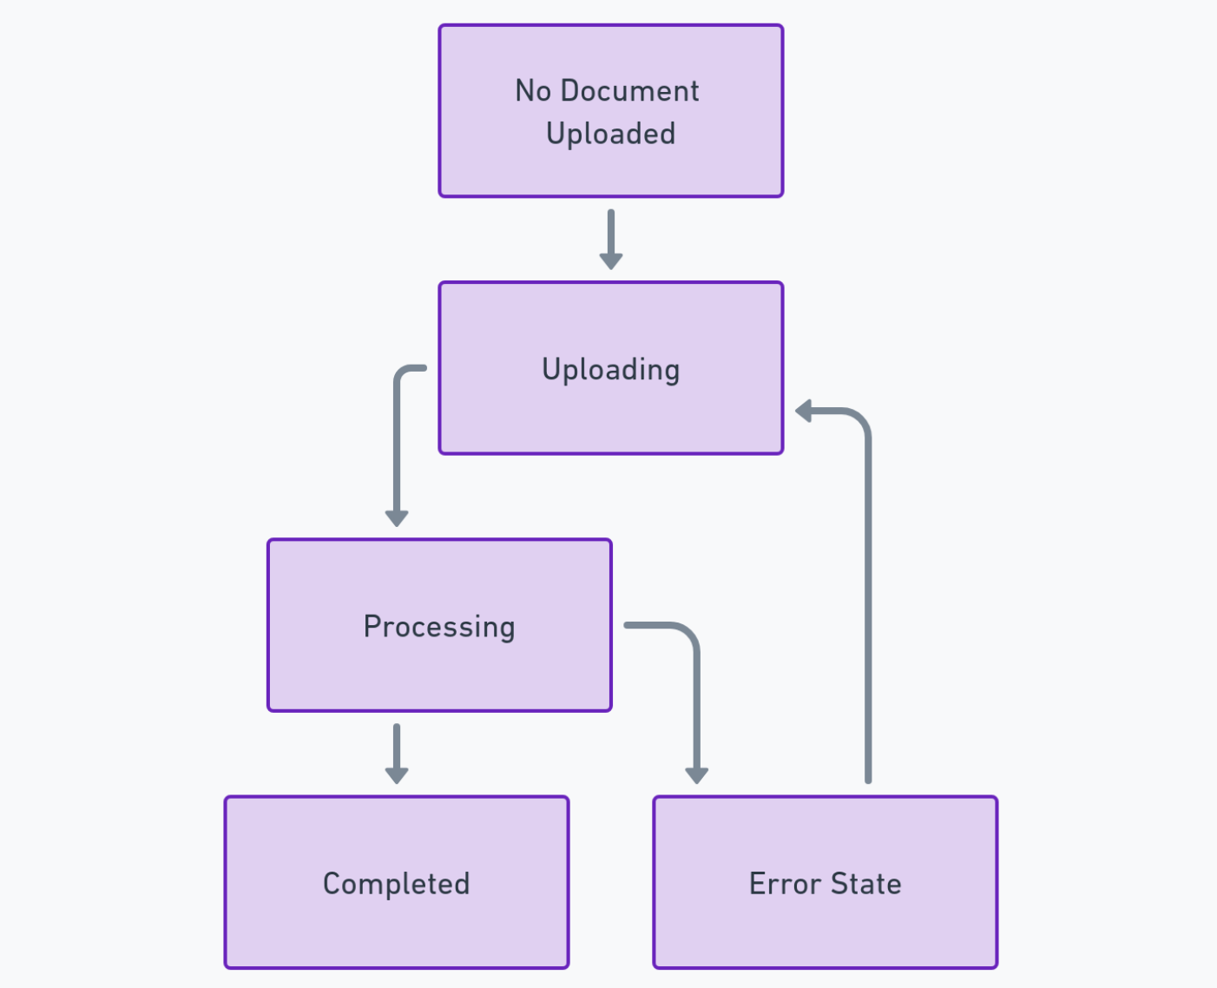
State Diagram
Notes:
Nuvorish

Slide 23
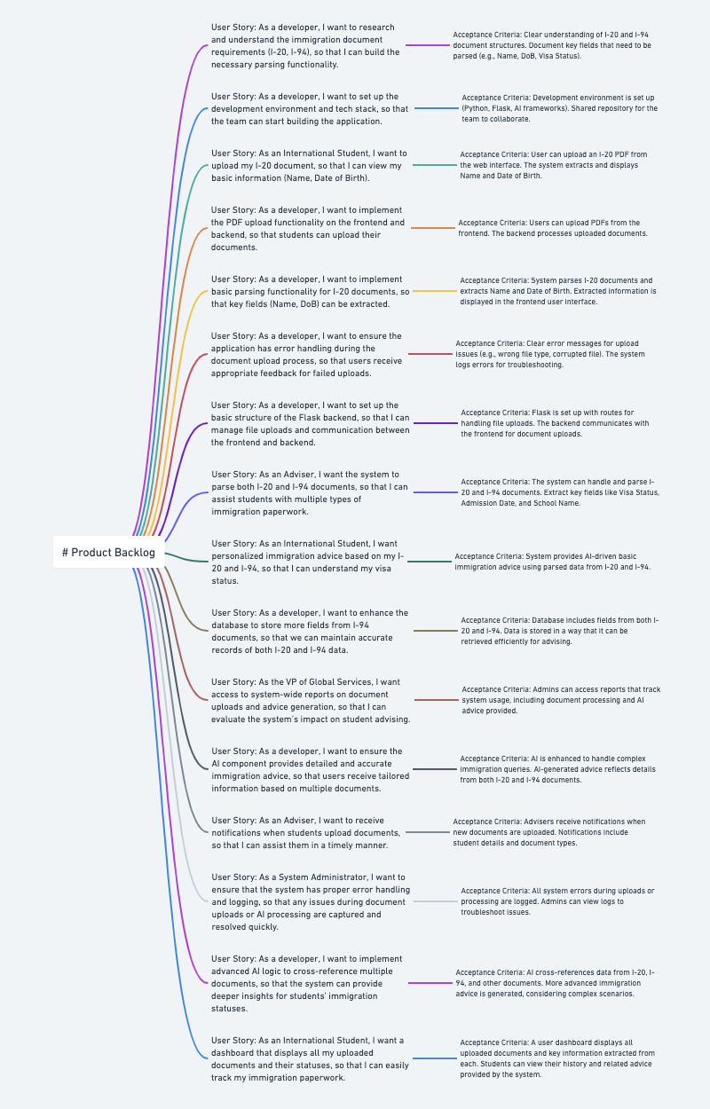
Notes:
Miles

Slide 24
Sprint 1 Backlog
Stories or Tasks committed for this Sprint
User Story: As an International Student, I want to upload my I-20 document, so that I can view my basic information (Name, Date of Birth).
Acceptance Criteria:
User can upload an I-20 PDF from the web interface.
The system extracts and displays Name and Date of Birth.
Story Points: 3
User Story: As a developer, I want to implement the PDF upload functionality on the frontend and backend, so that students can upload their documents.
Acceptance Criteria:
Users can upload PDFs from the frontend.
The backend processes uploaded documents.
Story Points: 5
User Story: As a developer, I want to implement basic parsing functionality for I-20 documents, so that key fields (Name, DoB) can be extracted.
Acceptance Criteria:
System parses I-20 documents and extracts Name and Date of Birth.
Extracted information is displayed in the user interface.
Story Points: 8
Notes:
Raj

Slide 25
Sprint 1 Backlog
Stories or Tasks committed for this Sprint
User Story: As a developer, I want to ensure the application has error handling during the document upload process, so that users receive appropriate feedback for failed uploads.
Acceptance Criteria:
Clear error messages for upload issues (e.g., wrong file type, corrupted file).
The system logs errors for troubleshooting.
Story Points: 3
User Story: As a developer, I want to set up the basic structure of the Flask backend, so that I can manage file uploads and communication between the frontend and backend.
Acceptance Criteria:
Flask is set up with routes to handle file uploads.
The backend communicates with the frontend for document uploads.
Story Points: 5
Total Story Points for Sprint 1: 24 Story Points
Notes:
Raj

Slide 26
Sprint 1 Backlog
Test Cases
User Story: As an International Student, I want to upload my I-20 document, so that I can view my basic information (Name, Date of Birth).
Story Points: 3
Test Cases:
Test that a valid I-20 PDF is successfully uploaded.
Verify that the system correctly extracts the Name and Date of Birth from the document.
Ensure that the extracted data is accurately displayed in the user interface.
Test how the system behaves when an invalid document is uploaded (e.g., incorrect format, corrupted file).
User Story: As a developer, I want to implement the PDF upload functionality on the frontend and backend, so that students can upload their documents.
Story Points: 5
Test Cases:
Test the PDF upload functionality from the frontend.
Verify that the backend successfully receives and processes uploaded files.
Test for the correct response when an unsupported file type is uploaded.
Check that files larger than the size limit trigger an appropriate error message.
Notes:
Santhosh

Slide 27
Sprint 1 Backlog
Test Cases
User Story: As a developer, I want to implement basic parsing functionality for I-20 documents, so that key fields (Name, DoB) can be extracted.
Story Points: 8
Test Cases:
Test the system’s ability to parse different I-20 PDFs (valid variations).
Verify the accuracy of the extracted Name and Date of Birth.
Ensure that extracted data is displayed correctly in the UI.
Test how the parser handles incomplete or incorrectly formatted I-20s.
User Story: As a developer, I want to ensure the application has error handling during the document upload process, so that users receive appropriate feedback for failed uploads.
Story Points: 3
Test Cases:
Test the system’s response to uploading unsupported file types.
Verify that corrupted or invalid files trigger appropriate error messages.
Ensure that error messages are user-friendly and informative.
Check that the system logs errors appropriately for further debugging.
Notes:
Santhosh

Slide 28
Sprint 1 Backlog
Test Cases
User Story: As a developer, I want to set up the basic structure of the Flask backend, so that I can manage file uploads and communication between the frontend and backend.
Story Points: 5
Test Cases:
Test that Flask is properly set up and handles HTTP requests correctly.
Verify that the backend routes handle document upload requests successfully.
Check that the backend returns appropriate success or error messages to the frontend.
Test communication between the frontend and backend during the file upload process.
Notes:
Santhosh

Slide 29
Sprint 1 Backlog
Stories completed
User Story: As an International Student, I want to upload my I-20 document, so that I can view my basic information (Name, Date of Birth).
Acceptance Criteria Completed:
User can successfully upload an I-20 PDF from the web interface.
The system extracts and displays the Name and Date of Birth from the uploaded document.
Status: Completed
User Story: As a developer, I want to implement the PDF upload functionality on the frontend and backend, so that students can upload their documents.
Acceptance Criteria Completed:
Users can upload PDFs from the frontend interface.
Backend successfully processes uploaded documents, handling the files appropriately.
Status: Completed
User Story: As a developer, I want to implement basic parsing functionality for I-20 documents, so that key fields (Name, DoB) can be extracted.
Acceptance Criteria Completed:
System parses I-20 documents and correctly extracts Name and Date of Birth.
Extracted information is displayed in the frontend user interface.
Status: Completed
Notes:
Santhosh

Slide 30
Sprint 1 Backlog
Stories completed
User Story: As a developer, I want to ensure the application has error handling during the document upload process, so that users receive appropriate feedback for failed uploads.
Acceptance Criteria Completed:
Clear error messages are displayed for invalid uploads (e.g., wrong file types, corrupted files).
The system logs errors for troubleshooting purposes.
Status: Completed
User Story: As a developer, I want to set up the basic structure of the Flask backend, so that I can manage file uploads and communication between the frontend and backend.
Acceptance Criteria Completed:
Flask is fully set up with routes for handling file uploads.
Backend and frontend communicate successfully, with files uploading and processing properly.
Status: Completed
Total Completed Stories: 5 Stories (24 Story Points)
Total Stories not completed: 0
Notes:
Santhosh

Slide 31
Metrics
Team Velocity - Sprint 1
Details:
The team successfully completed 5 user stories, focusing on core functionalities like PDF uploads, document parsing, and error handling.
Story points are based on the complexity and effort required for each story, not the number of issues.
Total Story Points: 24 Story Points
Notes:
Miles

Slide 32
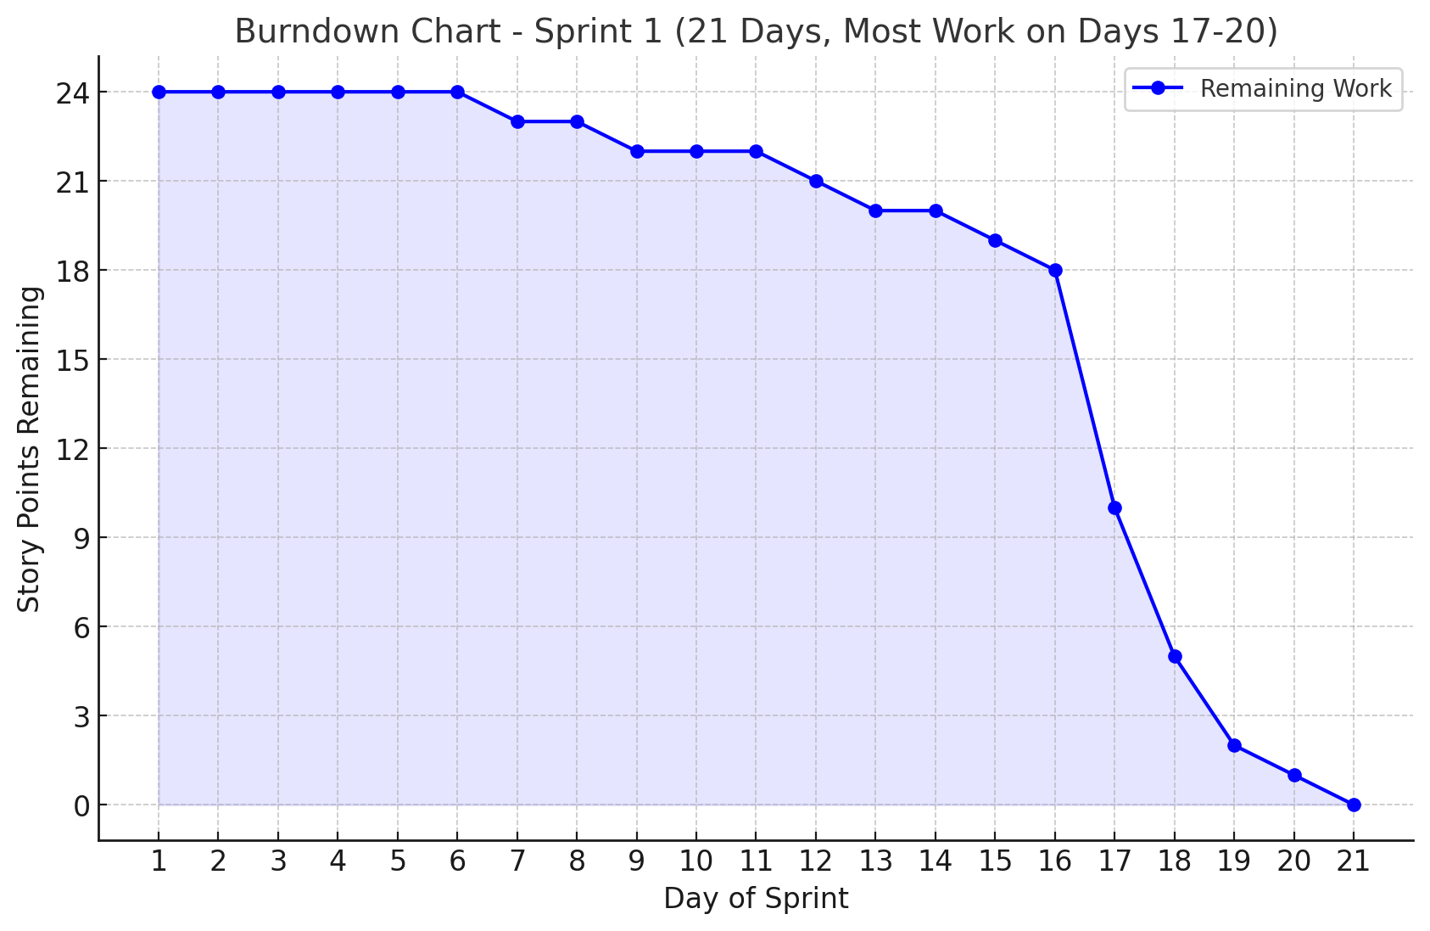
Metrics
Notes:
Miles

Slide 33
Metrics
Completed/Committed Ratio:
24/24 = 100%
Notes:
Miles

Slide 34
Retrospective
What Went Well?
Completed all tasks successfully.
On time for all scheduled meetings.
Gained a solid understanding of agile methodology.
Each team member delivered quality work.
Successfully designed and planned an MVP.
What Can Be Improved?
Overestimated tasks; could have accomplished more.
Overstated effort due to lack of capacity planning experience.
Incomplete velocity data, expected for a new team.
Could improve respecting deadlines.
Enhance workload distribution and collaboration.
Actionable Items:
Start recording demo videos 48 hours prior to deadlines.
Develop a structure and mechanisms for team accountability.
Improve capacity planning to better estimate task effort and timelines.
Continue refining workload distribution to ensure balanced collaboration.
Notes:
Nouvrish

Slide 35
Sprint 2 Planning and Commitment
Sprint 2: I-94 Parsing & AI Component
User Story: As an Adviser, I want the system to parse both I-20 and I-94 documents, so that I can assist students with multiple types of immigration paperwork.
Acceptance Criteria:
The system can handle and parse I-20 and I-94 documents.
Extract key fields like Visa Status, Admission Date, and School Name.
User Story: As an International Student, I want personalized immigration advice based on my I-20 and I-94, so that I can understand my visa status.
Acceptance Criteria:
System provides AI-driven basic immigration advice using parsed data from I-20 and I-94.
User Story: As a developer, I want to enhance the database to store more fields from I-94 documents, so that we can maintain accurate records of both I-20 and I-94 data.
Acceptance Criteria:
Database includes fields from both I-20 and I-94.
Data is stored in a way that it can be retrieved efficiently for advising.
Notes:
Matt

Slide 36
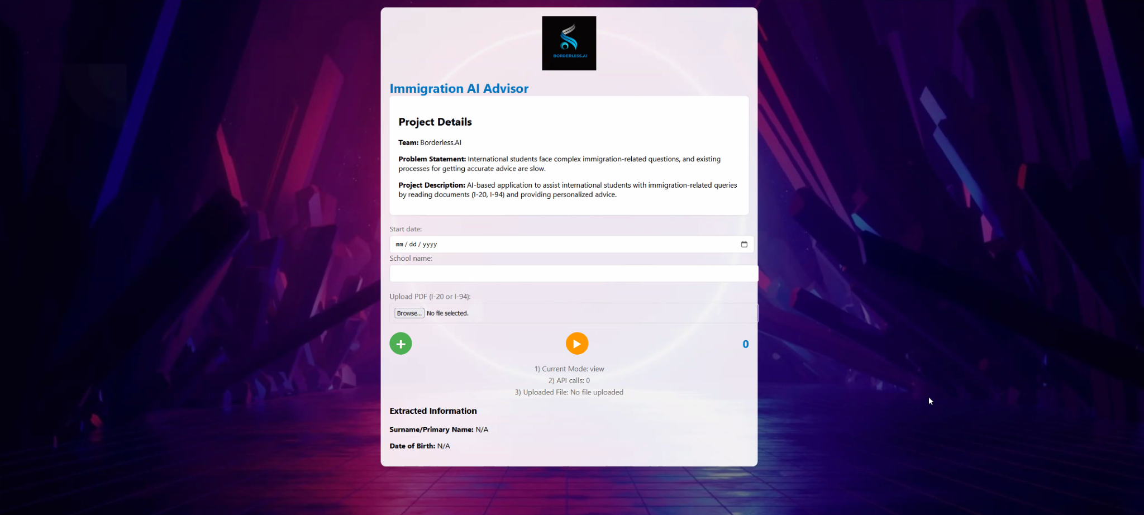
Project Demo
Notes:
Matt

Slide 37
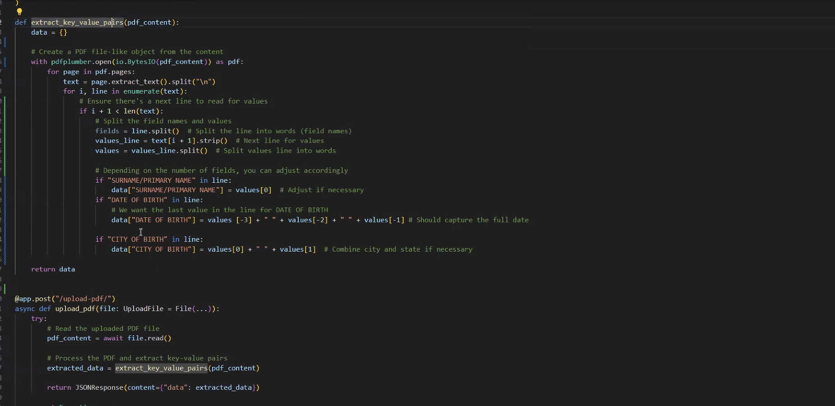
Project Demo
Notes:
Matt

Slide 38
Github Link
https://github.com/htmw/2024F-borderless.ai/wiki
Notes:
Matt

Slide 39
Live Application Demo
Notes:
Matt

Slide 40
THANK YOU!
Notes:
Miles

